Slide 1
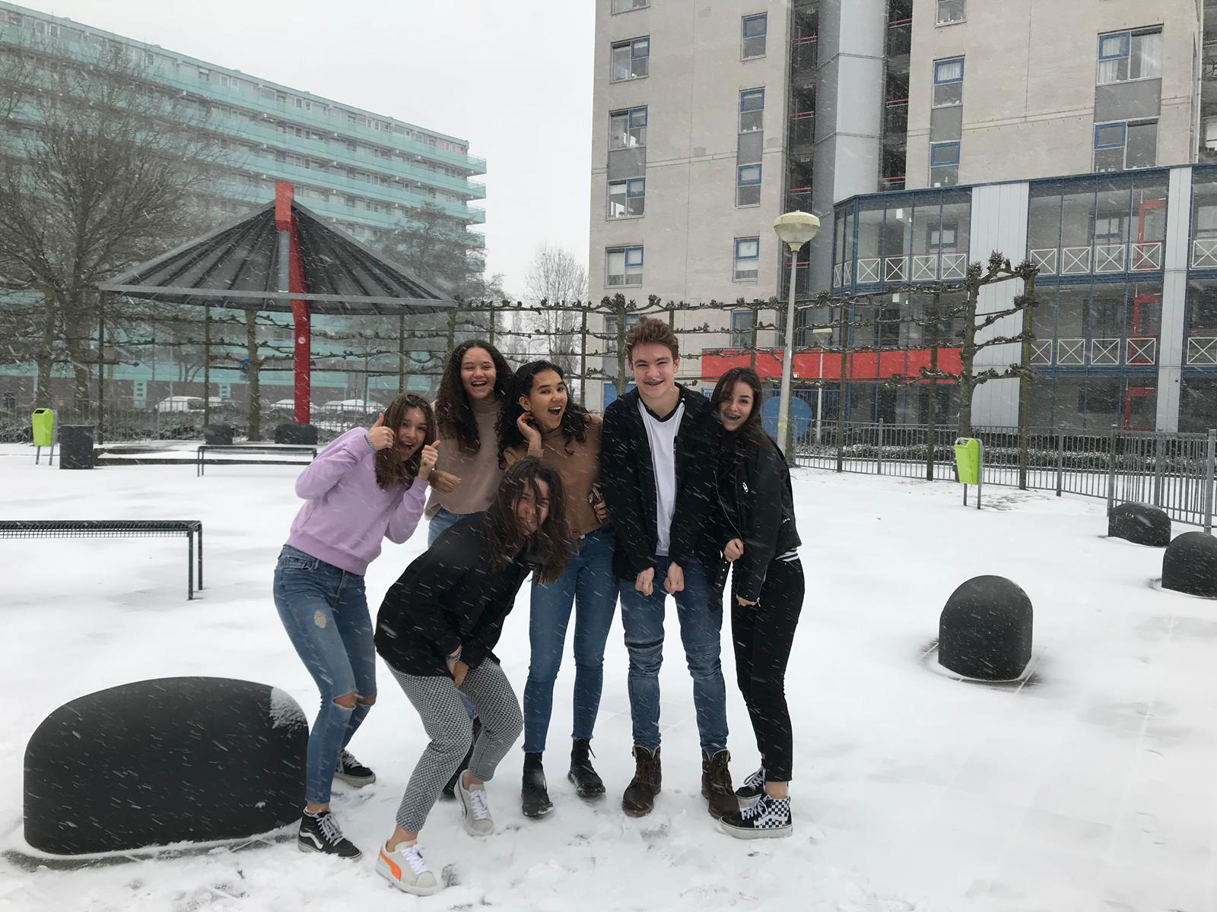
Family Life
India project

Slide 2
Index
Introductions (check Weebly)
Interviews
Comparison (our interviews)
Comparison (video conference)
Conclusion
Reflection

Slide 3
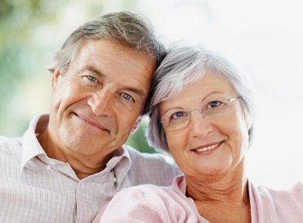
Interview Indy (grandparents)
1.How old are you?
2.Where do you come from?
3.Did you have a great family?
4.Did you have a good connection with your family?
5.Did you do fun things with your family?
6.What kind of job did your parents do?
7.Do you think you are raised well?
8.Do you remember a historic event that happened in India or Europe when you were aged 12 to 16?
9.What did your house look like?
10. With how many people did you live in the house?

Slide 4
Answers interview Indy (grandparents)
Grandma
1.71 years old
2.Originally from Hungary, born in Groningen.
3.Small family, 1 brother
4.Yes, they could tell each other everything.
5.Yes pretty often, ice skating for example or holidays to the beach.
6.Dad was Vee arts. Mom was at home (house wife)
7.Yes, not strict but good.
8.Kennedy was killed ( 16 years old)
9.Big house, with 4 people (mother, dad and brother)
Grandpa
1.75 years old
2.Born in Zwolle.
3.No also a small family.
4.Yes, it was pretty close family.
5.No, we didn’t have the money for it.
6.Mom was also house wife. Dad was captain on bagger-ship
7.Yes, strict but righteous
8.Flood disaster(10 years old)
9.Quite a big house, lived with 5 people (mom, dad, brother and sister)

Slide 5
Interview Jazzebelle
Jazzebelle Daalman.
Interview with my mom
- Whats your name?
Manuela van den Bogeart.
-When were you born?
26 Juli 1971.
-How many persons did your family consists of?
2 kids ( two girls ) and 2 adults.
- Were your parents working a lot?
Yes, my dad was working all the time, but my mom was always at home.
- Did you have to work as well of did you have to help your parents with work?
No, I never had to help them with their work, but when I was 15 years old I always had small jobs, but that was because I wanted that myself.
- Did you enjoy being at home?
Yes, it was very cosy at home and I had 3 dogs that I loved very much.
- Did you go on little trips often with your family?
Yes, we went to things like the cinema, zoo or themepark. Every summer we went to Italy.
-Do you remember a historical happening that happened when you were young?
Yes, the switch of the queen ( Juliana ) to another queen ( Beatrix ) that was really impressive.

Slide 6
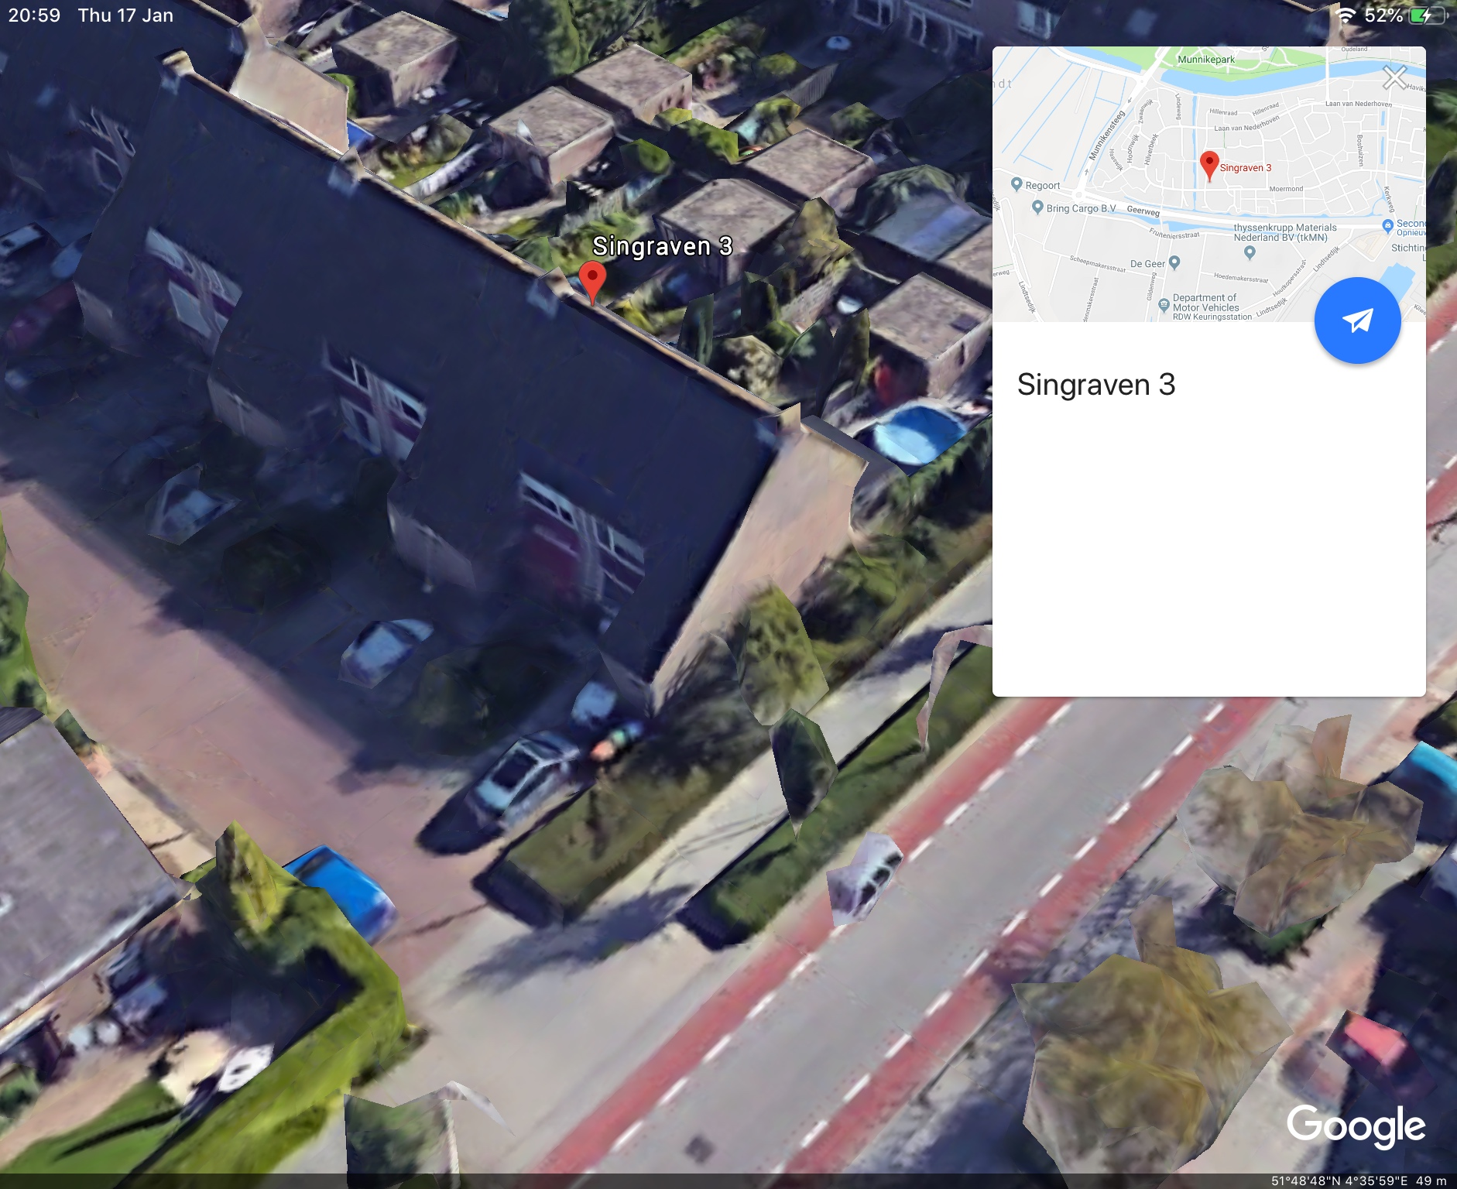
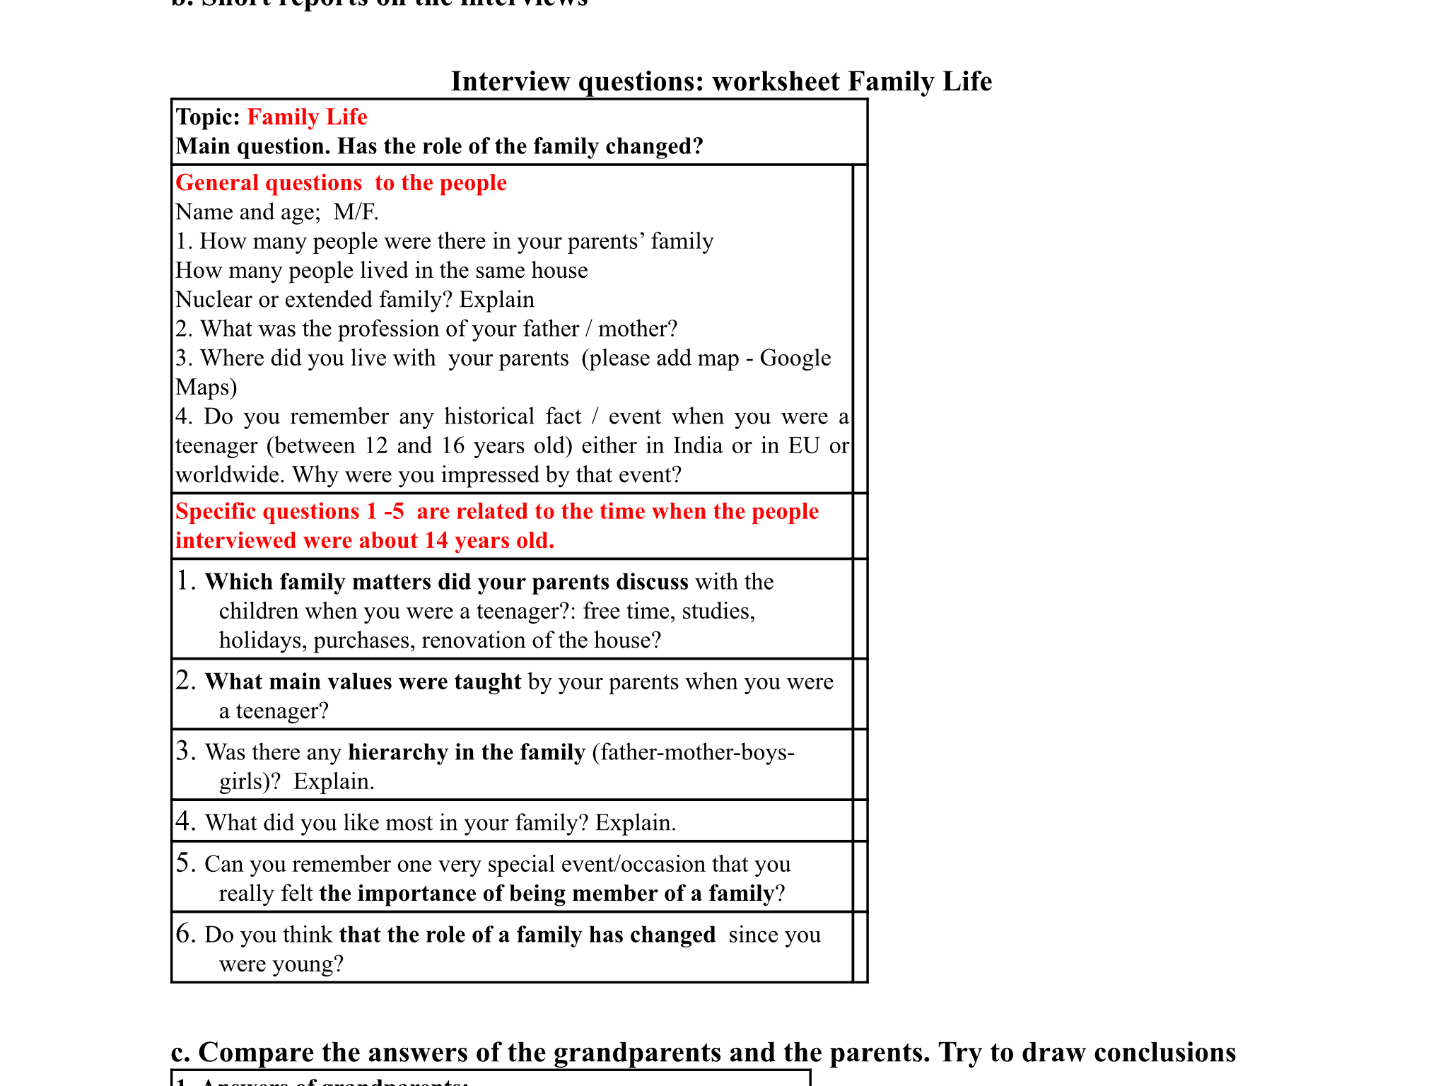
Interview Milan
Peter Versprille, 49.
I interviewed my dad. You can see the questions on the picture.
1. My father has a sister too, so the family consisted of 4 people. The family size was average. Most families consisted of 2 adults and 2 children.
2. My father works at the office of a hospital. He’s a controller of Albert Schweitzer.
3. You can see the house if you look at the picture.
4. My father really liked live aid. Live aid was a 16 hour long concert with a lot of famous bands like Queen. The goal was to gather money for Africa.
5. My father would always go to Italy with his family. Most of his free time was spend by playing football outside, but he would always finish his homework before going outside, because he thought that was more important.
6. My father thinks school is very important. He always says to me I have to be grateful for the things I have here.
7. No, but off course I have to listen to my parents. I also have to be respectful to my grandparents, but I think that’s normal.
8. I can say everything to my parents, they would always listen to me when I have problems and when I have a problem, they try to come up with a solution.
9. When it’s Christmas every family member comes to our place for a nice dinner. We usually give presents to each other during Christmas.
10. No I don’t think so, but my childhood is very different compared to the childhood of my dad. I think it’s partly because of technology.

Slide 7
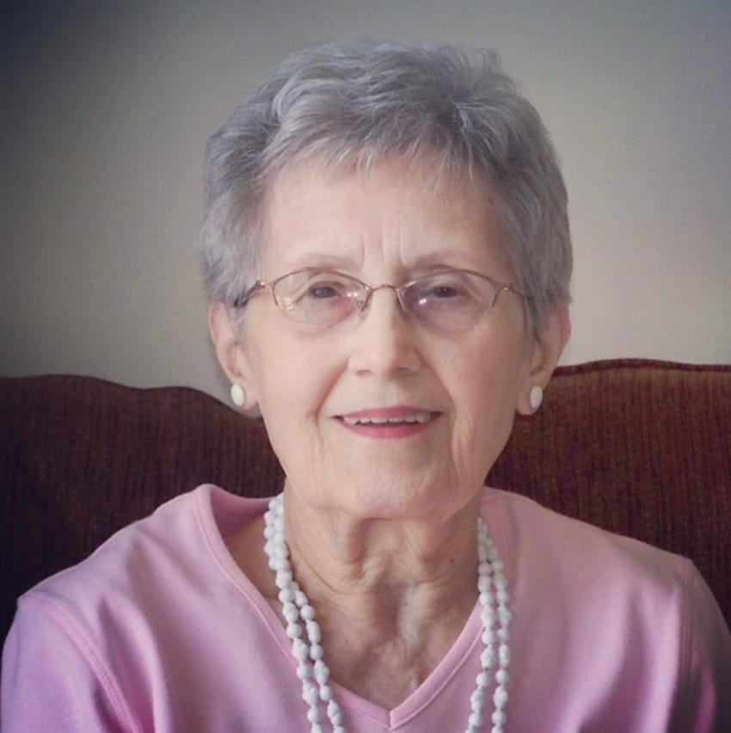
Interview Lotte I interviewed my Grandmother, Marjan Hammer.
Questions.
1.How many people were there in your parents family?
2.What was the profession of your parents ?
3.Where did you live with your parents ?
4.Do you remember any historical facts that impressed you from when you were young?
5.With how many people did you live?
Answers
1. Grandma: ”I don’t know exactly how many people but I had a big family with a lot of cousins”.
2. Grandma: “my father was a boatman, transported containers and my mother was teacher in needle art”.
3. Grandma: “I lived on my fathers ship called the San Antonio. “
4. Grandma: “your grandpa still remembers when the first nuclear bomb fell, and I remember when the Russian president Chroesjtsjov threw his shoe during a meeting”.
5. My parents, my older sister, my younger brother and me.

Slide 8
Interview Isa (questions)
1. What’s your name (f,m)?
2. How old are you?
3. Where are you from?
4. Did you have a big family?
5. Did your family had a good relationship?
6. Did you do some fun stuff with your family?
7. What did your parents do for work?
8. Do you think you’ve been raised well?
9. Do you remember a historical moment when you were between 12 and 16 years old?
10. What did your house look like? How many people are in your family?

Slide 9
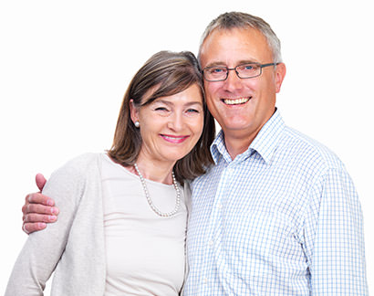
Interview Isa (answers)
Sandra Verhagen (F)
Peter Verhagen (M)
47 years old, born on 19th of august 1971.
48 years old, bron on the 31th of may 1970
from Hendrik- Ido- Ambacht
from Rotterdam
yes, because my father had a lot of brothers and sisters so my family was very big.
No not really
no, because I had 42 cousins from only one side of the family so only with a few.
no not really
yes, i dont have a very big family so i had a pretty good connection.
no, because my father was always working and my mother was always ill.
Yes, we went to the cinema, zoo, on holiday etc.
My dad was a owner of a wholesale and a buyer of groceries and froot, my mom was a housewife
My mom was a housewife and my dad was liquor.
yes but very old fashioned.
Yes.
no
live aid , it was a concert with a lot of people all over the world to get money for a charity.
we lived with 6 persons in one house , it was not very different from now but it was furnishes in a retro style.

Slide 10
Interview Ludisha
1.In her fathers family there were 7 people. In her mothers family there were 5 people.
2.Her dad was a metalworker.Her mom was a shop assistant.
3.They lived in west-dordrecht, Zuidendijk.
4. She strongly remembered the Gulf War from 1990 to 1991, because she then realised that history could repeat itself and that there could be a declared war.
5.When she went on holiday with here family, she received a certain amount of money and het parents gave her instructions on hoe she should and shouldn’t spend it.
6.“Kalmte kan je redden.”Which means that being calm can safe you, meaning in certain situations you have to be calm rather than worrying about it.
7.No, her family was quite modern in these topics. They were told that men and women were equal. There wasn’t really a difference between the ways of raising boys and girls.
8.That there was a lot of freedom in their family in terms of thinking and doing, yet they did know how to respect others.
9.Her mom died when she was five year old because of cancer. She got a lot of support from all of her family members.
10.Yes, she misses the being together in families. That joined families used to be together all the time, not just on special occasions.

Slide 11
Comparison (interviews)
Comparison Question 1: how many people were there in your family ?
Our grandparents lived in a house with about 6 people average. Compared to how our parents families and our families that is pretty big, because that average is about for so you see that the families got smaller. You also notice that most grandparents didn’t know exactly how many people there were in their whole family, because there were too much.
Question 2: what kind of job do your parents have?
All our grandfathers did have jobs. Some worked on a ship and others just in town. The grandmothers were mostly housewives. They sometimes did have small jobs like needle art. In the next generation, so our grandparents it was still a bit the same. The men worked and the women were still housewives. Only 1 grandma started working when her two children were old enough to take care of themselves. Nowadays men and women have jobs.
Question 3: what kind of fun things did/ do you do with your parents?
We noticed that our grandparents didn’t do a lot of fun stuff with their family because there was just not enough money to be able to do that. They sometimes did go on a vacation but not as often as we do now. Our parents on the other side did do fun stuff with their family quite often. For example going on a vacation. We go on a vacation once a year or more and do other fun things like visiting a theme park.
Question 4: what is one life lesson thought by your family?
We think this is the same for everyone in every generation. Just to be respectful and kind to others.
Question 5: did you sometimes have to help your parents?
We sometimes help our parents in the household, so small things like putting the garbage outside or doing some forgotten grocery shopping. Our parents did sort of the same. But our grandparents did help more in the household.

Slide 12
Comparison Video conference
Comparison Video Conference
1.What kind of work do your parents do? Answer: Business man
2.Do you have to help with their work? Answer: Not really
3.With how many people do you live in a house? Answer: 4/5 nuclear, joined 15
4.What kind of fun things do you do with your family? Answer: We go to a movie/to the beach
5.What is one life lesson taught by your parents? Answer: Be kind, honest and polite
6.What kind of work did your grandparents do? Answer: A business man
The connection wasn’t really good. The students often asked if we could repeat the question, because the sound wasn’t clear. In Some things they were kind of the same like the fun things we do. The parents also say to their kids that they have to be kind, polite and I think that our parents also are trying. Their answers weren’t really different from ours.
They mostly live with 4/5 people in one house and you can see it in the Netherlands too. Not as often, but there are big families in the Netherlands. We didn’t really expect that their parents were business men because it seems like India is quite a poor country, however we don't really know in what sector the business is in, so it could be anything. In the Netherlands we don't usually have a really big family so we have quite a good bond but it can differ per family. They said that when they do nice things they usually go to the beach and to the cinema so they do quite the same things.

Slide 13
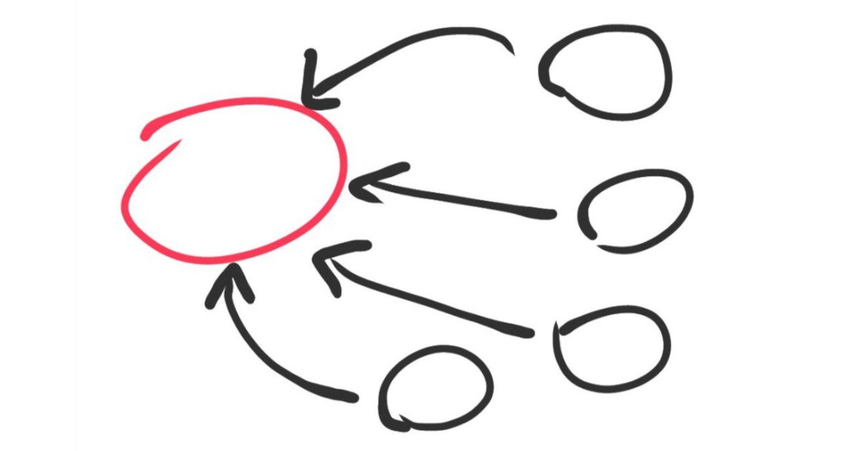
Conclusion
The difference between the two countries is huge, but in a couple of years they will be in the same stage as we are now.
The Indian students didn’t give clear answers and the connection wasn’t good. We could understand them after thinking about their answers a few times. They said their parents and grandparents were business men. We don’t exactly know what they meant with it. They can be an owner of a small shop in the city or they can be business men like we see them (with a big office in a city).
The 2 perspectives are really different from each other and that’s why this was a fun and interesting project/experiment.

Slide 14
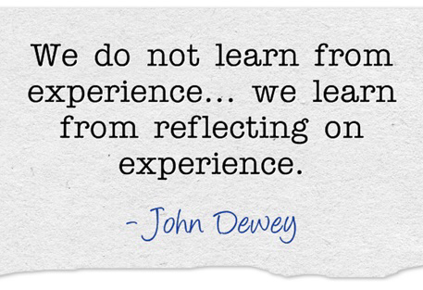
Reflection
The collaboration between the people in our group was really well organized.We divided the tasks equally, everyone participated and finished their own tasks on time. However we could have worked faster, so that we would have had more time for improvement. We all have gained more general knowledge about India, for example about the history, the current caste system, the different religions, the economy, etc.
Overall this was a great cooperation, we all gained lots of knowledge and we found it very interesting talking to Indian students.

